Slide 1
MILAN
Machine Inception Learning Algorithm Network
A.Erfani, F.Coba, A.Abraham, K.Danger
November 7 2018, Washington, DC
Notes:
Aref Slide

Slide 2
Learning how to learn
Meta-learning is an exciting trend of research in the machine-learning community which tackles the problem of learning to learn; aka Automated machine learning (AutoML)
The traditional paradigm in machine learning research is to get a huge dataset on a specific task, and train a model from scratch using this dataset (www.medium.com)
We investigated the behavior of multiple ML algorithms versus random data sets, and utilized a very preliminary criterion of effectiveness (Train vs Test)
Tools Used: Python, Tableau, Kaggle, Github, GraphViz, Bash, Machine Learning, Pandas, Numpy, Matplotlib, Sklearn, MLPClassifier, KNeighborsClassifier, ElasticNet, RandomForestClasifier, Tree, SVC, Logistic Regression, KMeans, GaussianNB, Excel, dtreeviz.
Notes:
Aref Slide

Slide 3


Project
Feed
Feed
MODELS
Decision Trees
Random Forest
Support Vector Machine
Logistic Regression
K-Nearest Neighbor
Neural Networks
Elastic Net
K-Means
Naïve Bayes
Accuracy of model
Python Panda
8 Datasets
Feed
We wanted to explore the model accuracy
Notes:
Andy Slide

Slide 4
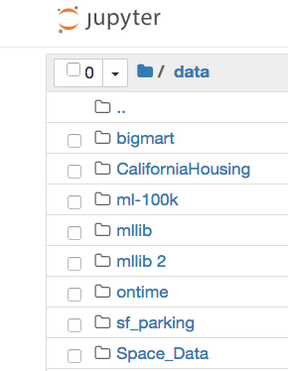
Datasets (feature (columns) X dimension (rows))
Titanic (12 X 892)
Flight (11 X 476,881)
California Housing (10 X 12,640)
Wisconsin Breast Cancer(30X569)
Stocks (2 X 649)
Earthquakes (15 X 8,223)
Big Mart (12 X 14,204)
Space (16 X 1,048,576)
Notes:
Andy Slide

Slide 5
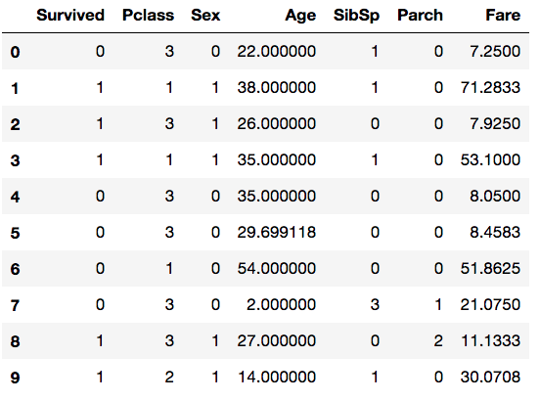
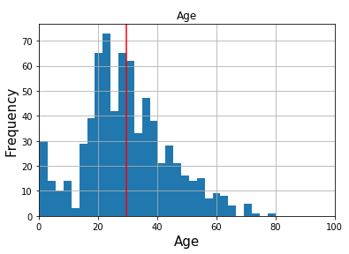
Titanic Data Processing
Age column had a few NaN. We calculated a histogram which calculated the mean age distribution.
Notes:
Kapil Slide

Slide 6
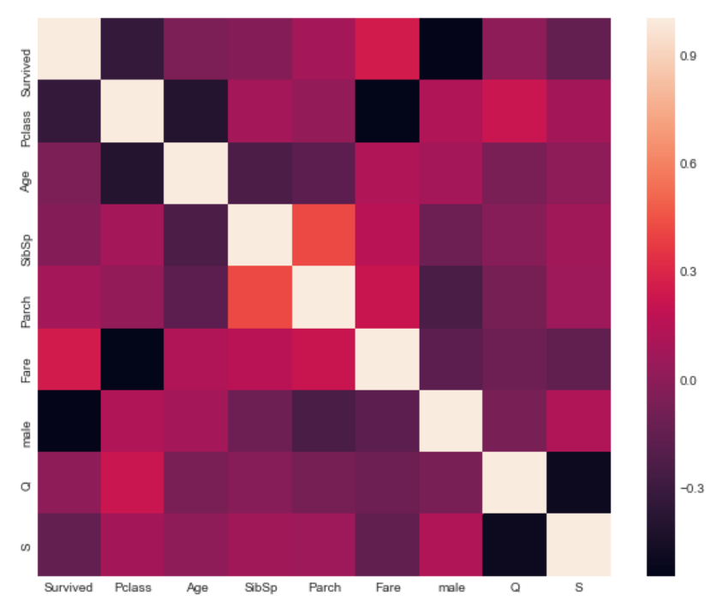
Titanic Heat Map
From linear regression
Notes:
Kapil Slide

Slide 7
Decision Tree Code
target = data["Survived"] target_names = ["yes", "no"]
variable = data.drop("Survived", axis=1)
feature_names = variable.columns
variable.head()
from sklearn.model_selection import train_test_split
X_train, X_test, y_train, y_test = train_test_split(variable, target, random_state=42)
clf = tree.DecisionTreeClassifier()
clf = clf.fit(X_train, y_train)
clf.score(X_test, y_test)..........0.757847533632287
clf.score(X_train, y_train)........0.9820359281437125
Notes:
Kapil Slide

Slide 8
"Pros and Cons of Decision Trees"
"
Pros
• Simple to understand; no representational mysticism. Trees can be drawn out.
• No need to normalize or standardize (need to deal with missing values).
• Low cost
• Handle multi-output
• Validate with Statistics!
• Handles wrong assumptions."
Cons
• Prone to overfit (deep trees don’t generalize)
• Minor variations in data cause big changes in tree structure (unstable) - fix with ensemble methods.
• Create biases if some classes dominate
• Some functions are impossible to model"
Notes:
Kapil

Slide 9
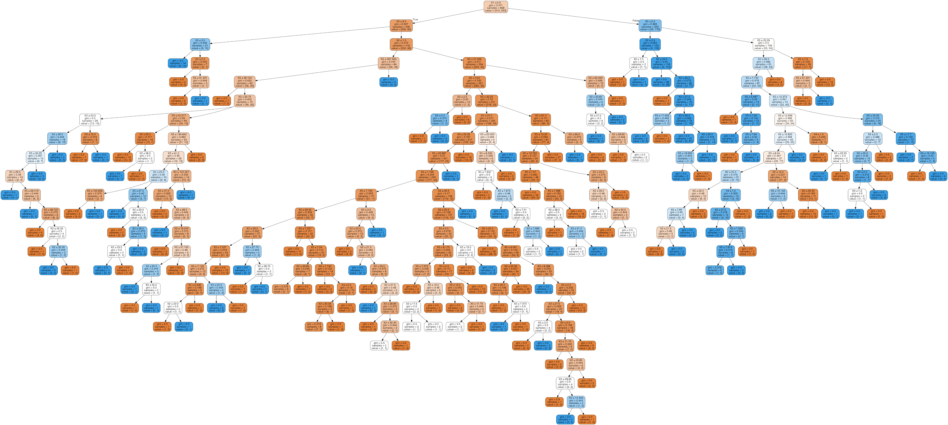
“Titanic” Decision Tree (numbers only)
Default
parameters
Notes:
Filis Slide

Slide 10
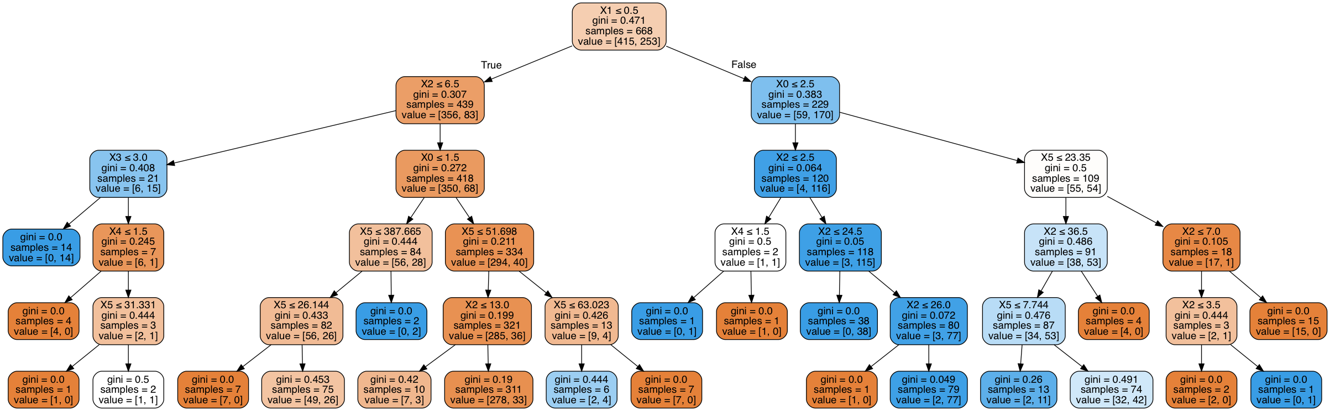
“Titanic” Decision Tree (numbers only using Sklearn)
X0 = Pclass | X1 = Sex | X2 = Age
X3 = SibSp | X4 = Parch | X5 = Fare
max_depth = 5
Notes:
Filis Slide

Slide 11
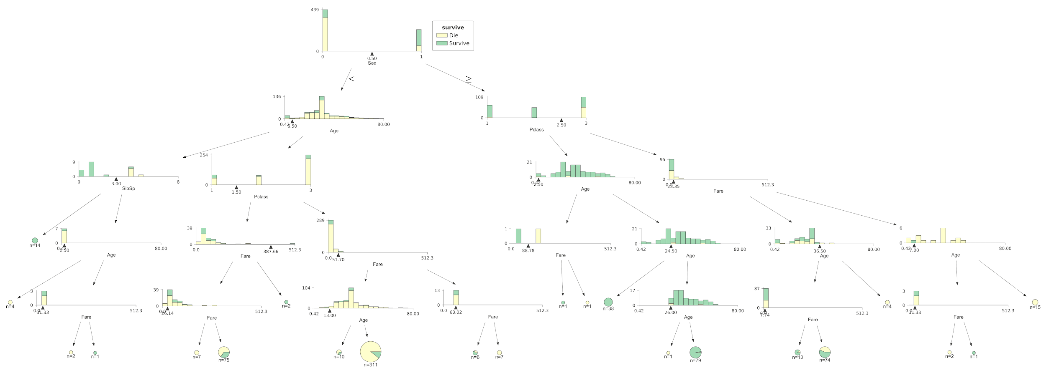
“Titanic” Decision Tree (bar graph representation using dtreeviz)
Notes:
Filis Slide

Slide 12
Titanic Decision Tree
(detail)
0 = Male
1 = Female
6.50
0.42
80.0
Created with dtreeviz in jupyter notebook using Titanic dataframe
Notes:
Filis Slide

Slide 13
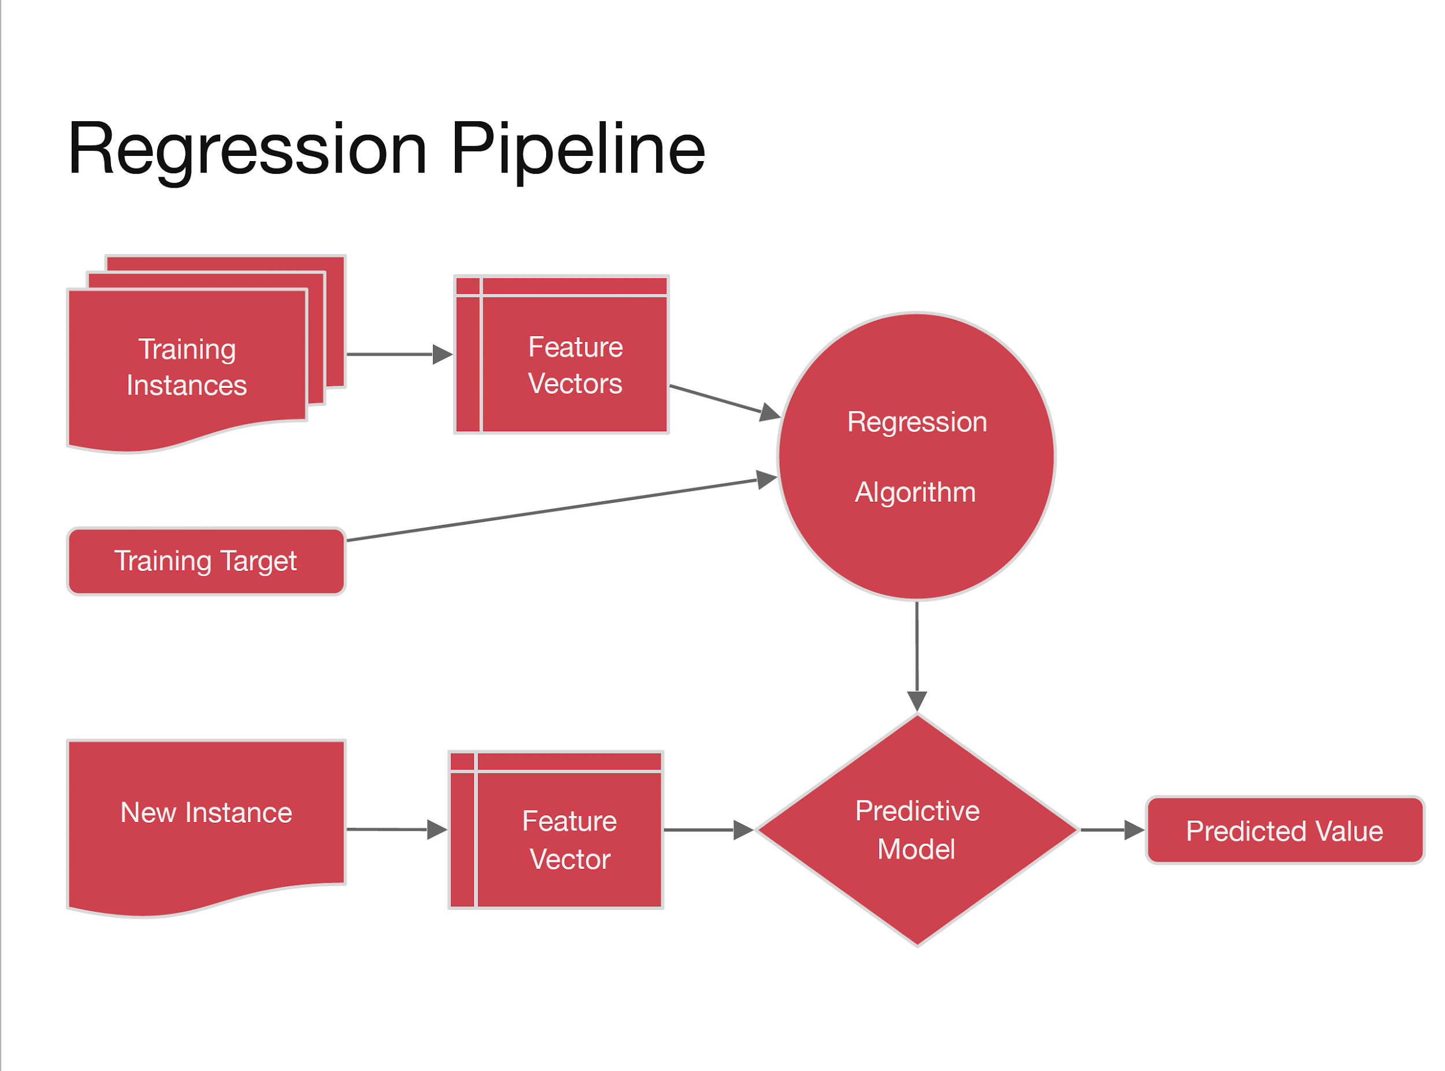
Notes:
Kapil

Slide 14
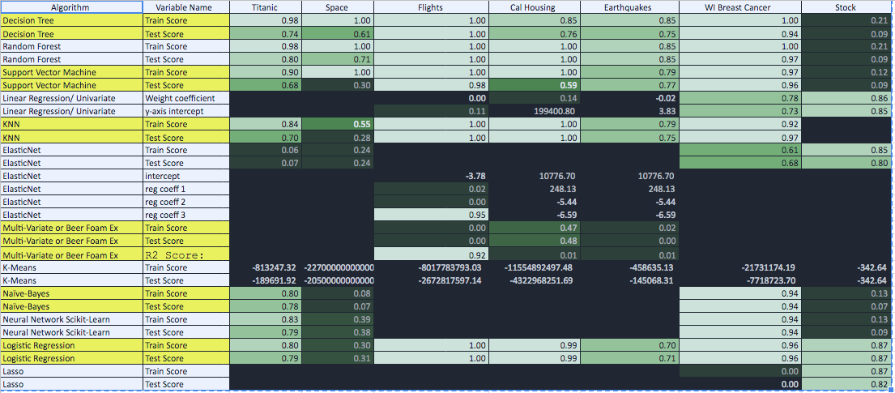
Which Model Performed Best?
Notes:
Aref Slide

Slide 15
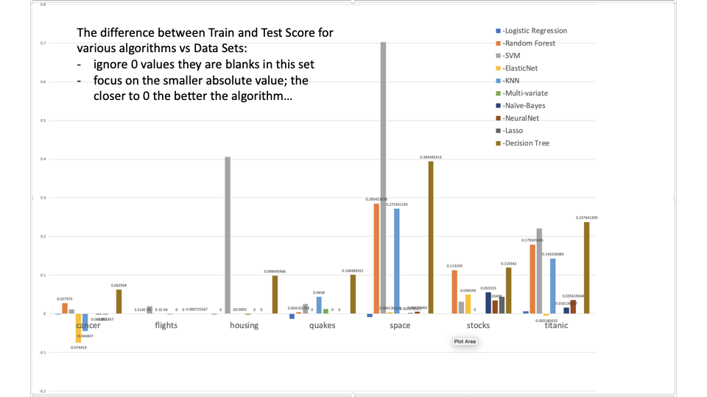
Notes:
Aref slide

Slide 16
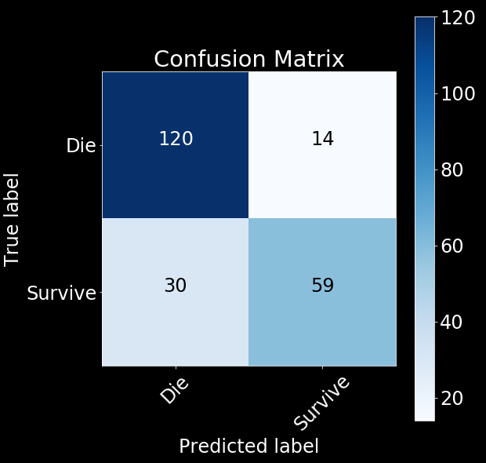
Confusion Matrix (Decision Tree | Titanic Data)
How confused was the model?
Model correctly predicted 120 people who died (top left square).
Incorrectly predicted 14 people survived when they actually died (top right square)!
Notes:
Filis Slide

Slide 17
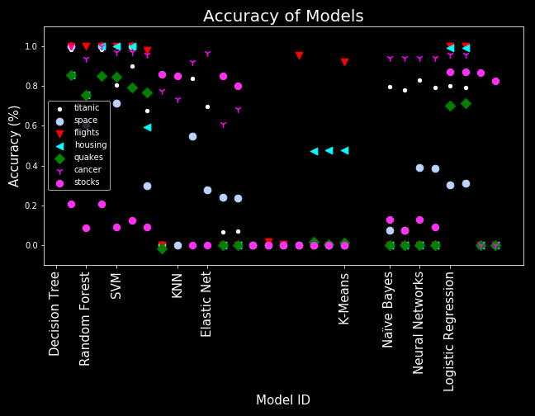
How accurate was each model on all data?
Large cluster at the top left indicates more model accuracy on all the data.
Cancer and Titanic data did well with neural networks, whereas housing and quakes did not.
Notes:
Filis Slide

Slide 18
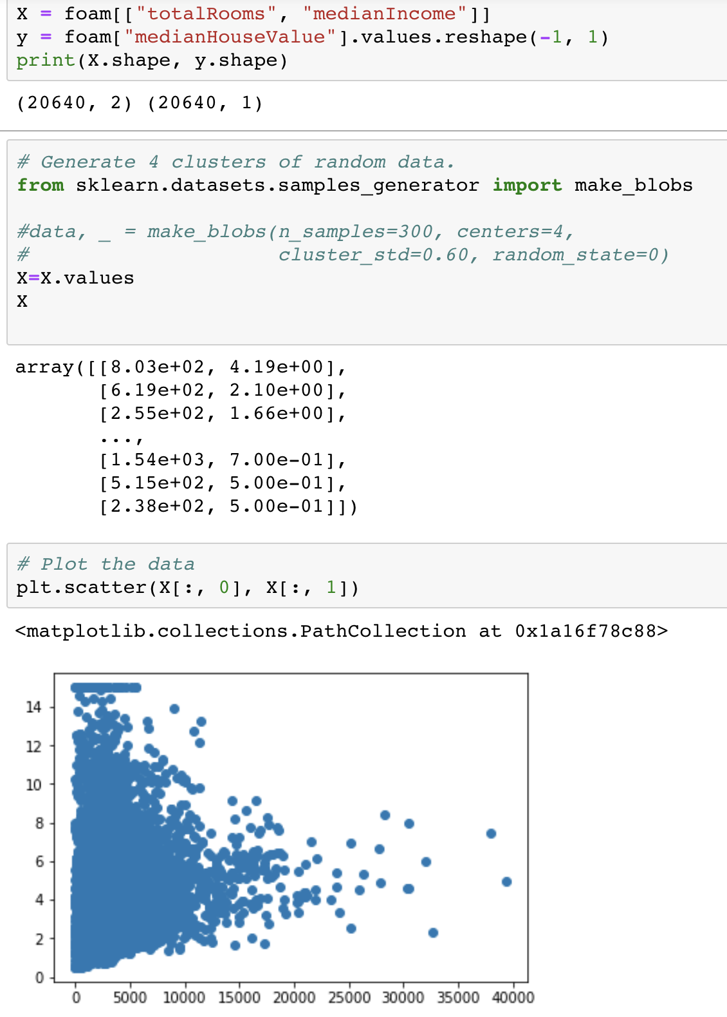
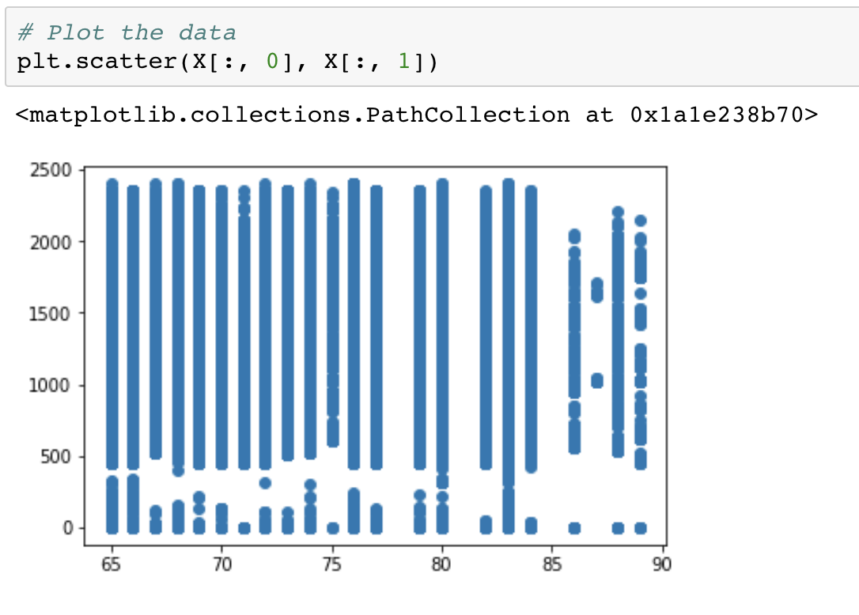
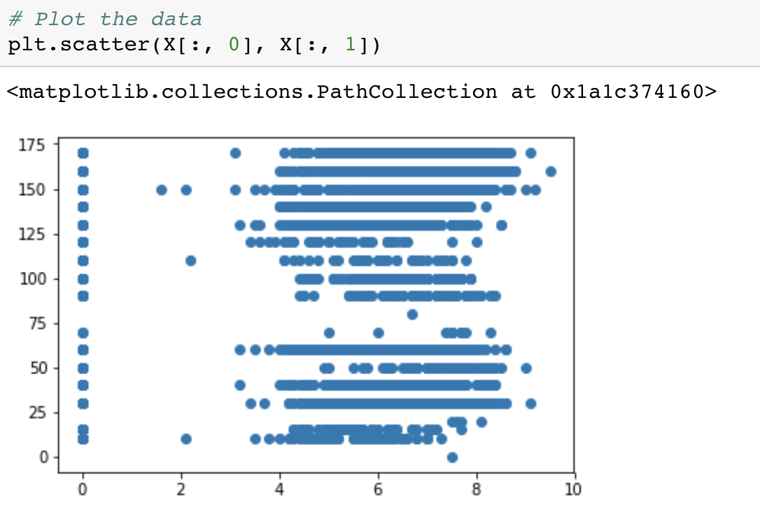
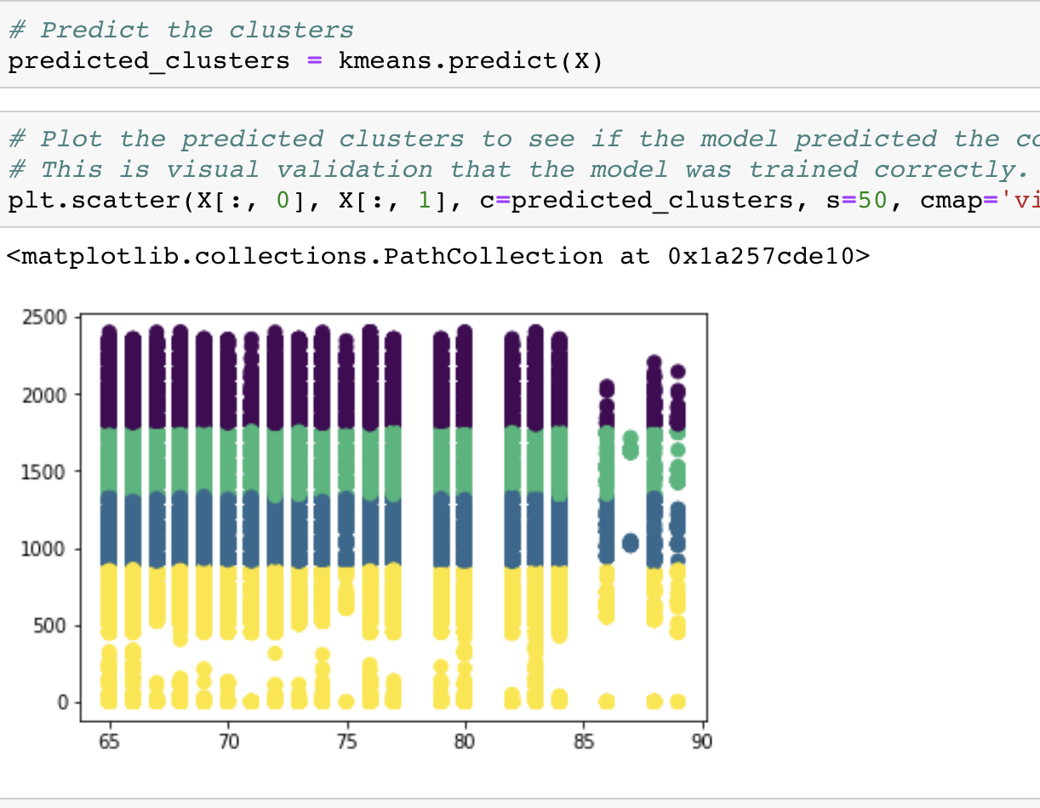
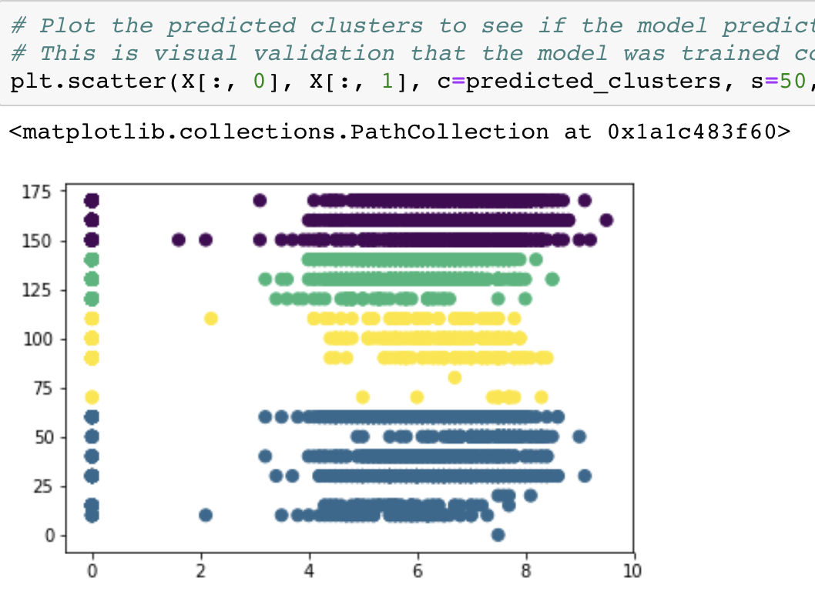
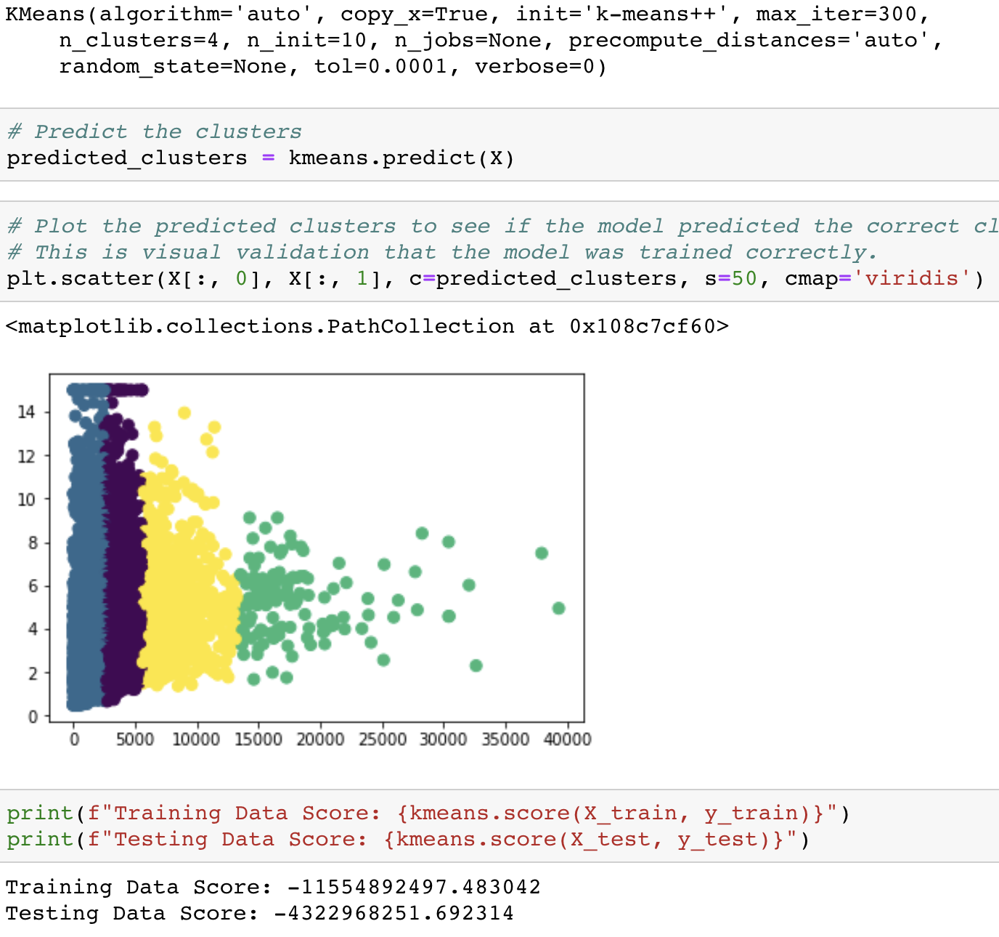
Sample output from data sets and algorithms: K-Means
Cal Housing
Flights
USGS Earthquakes
Notes:
Aref Slide

Slide 19
Pros and Cons of K-Means
Pros:
• Will find most optimal centers for the cluster
• Clusters are spherical
• Will converge to a solution
Cons:
• What K to use?
• Hard boundaries (no gray areas)
• Spherical clusters
• Stochastic: randomly determined
Notes:
Kapil

Slide 20
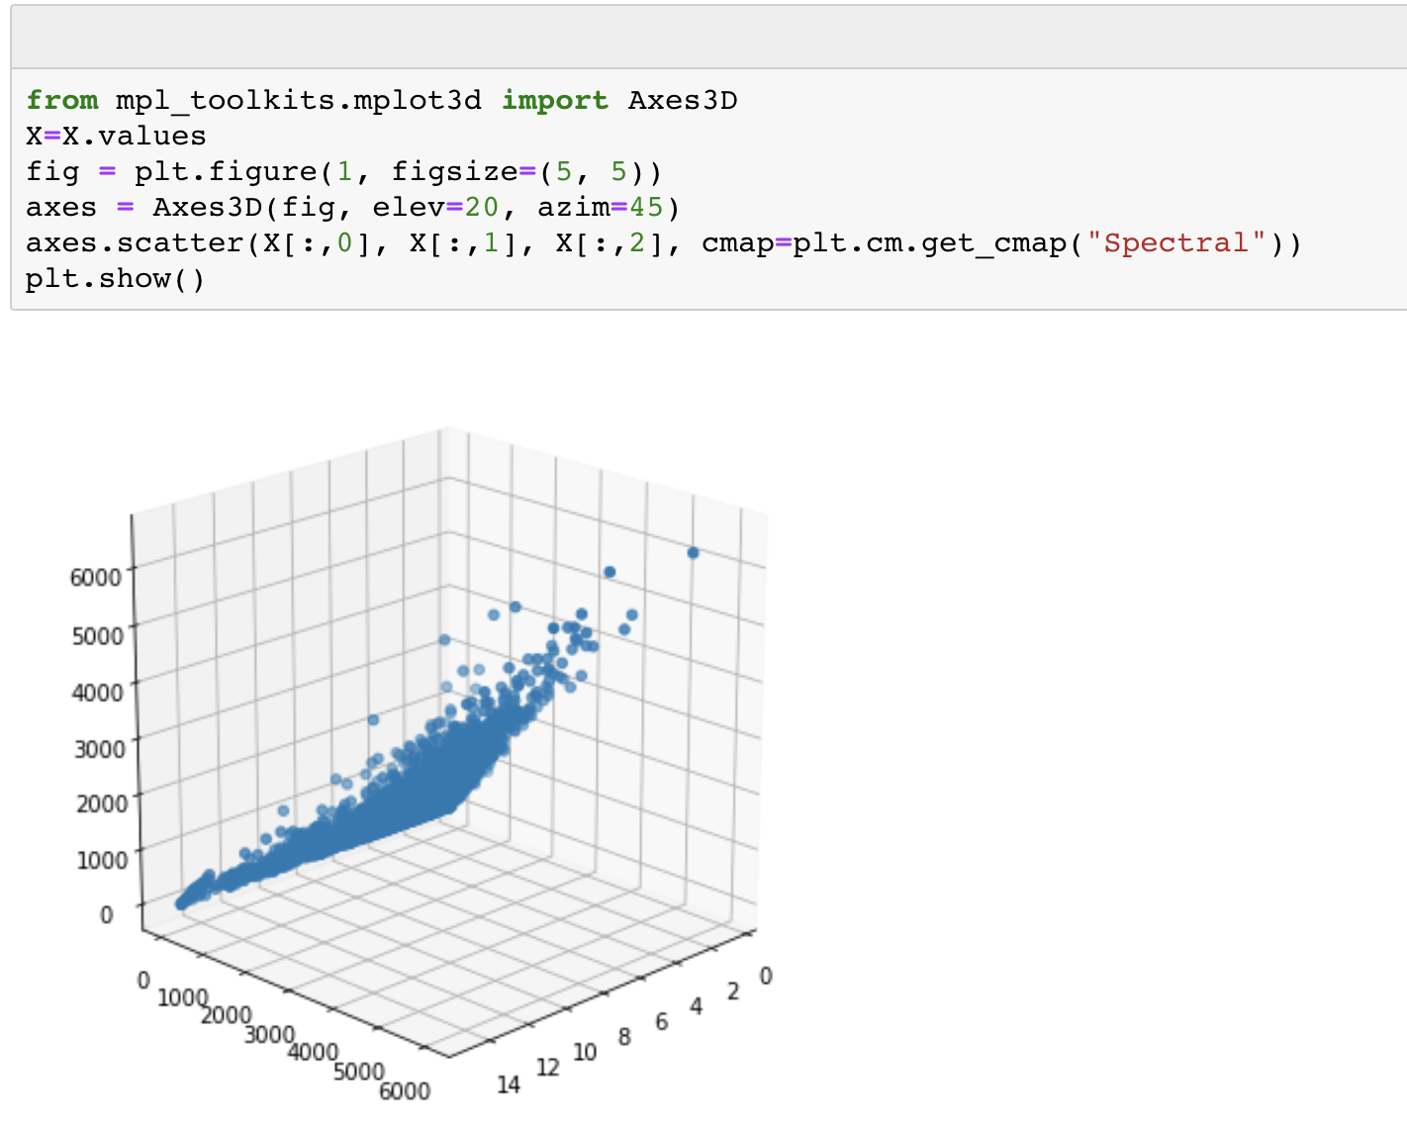
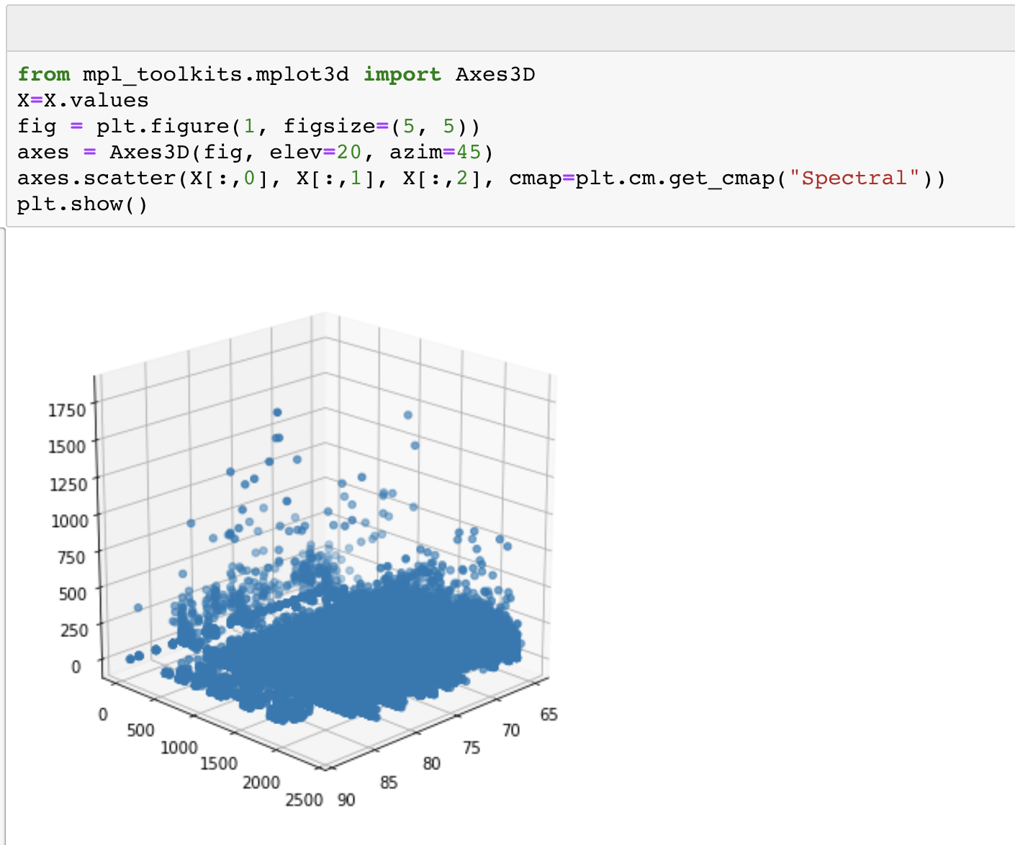
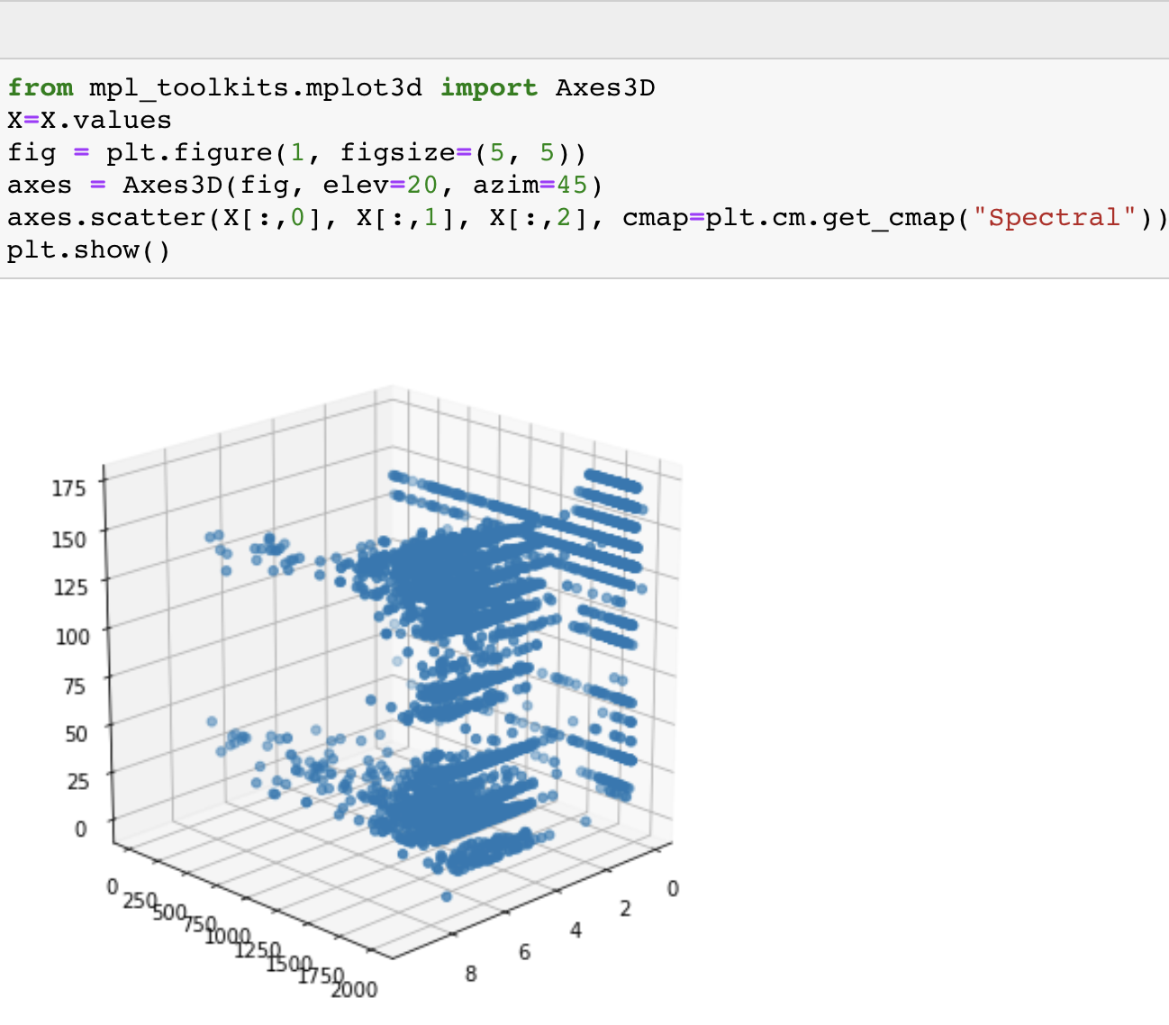
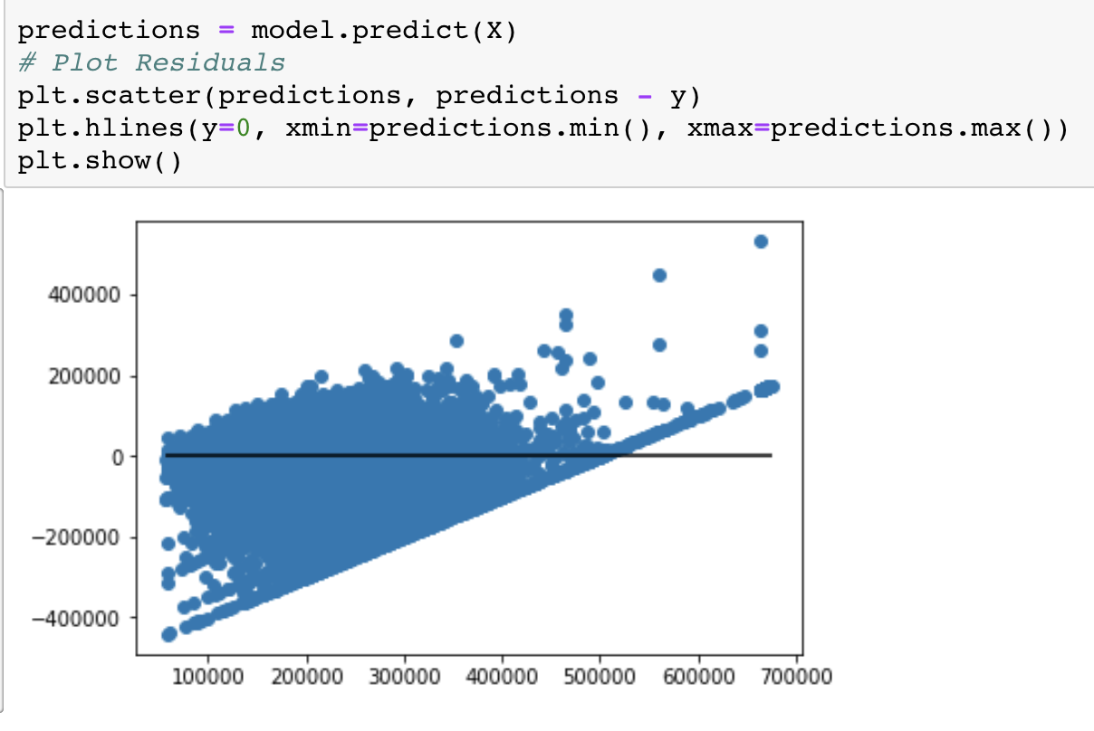
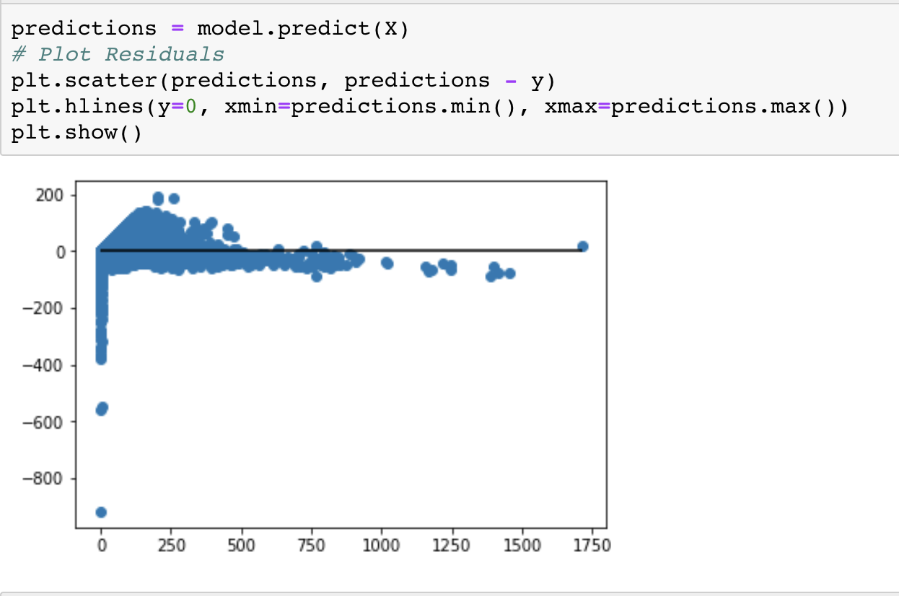
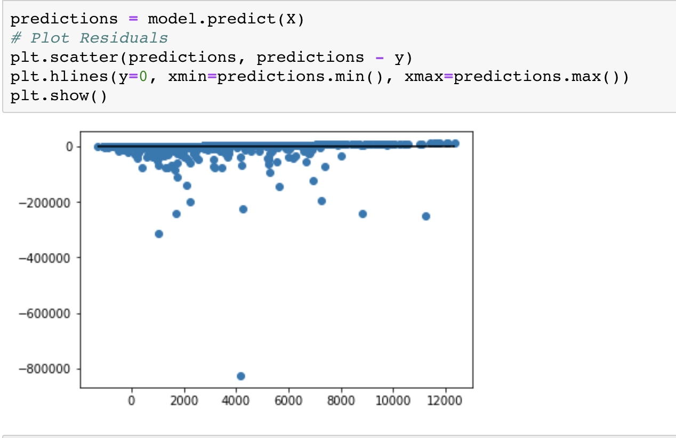
Multivariate Linear and Elastic Net
USGS Earthquakes
Cal Housing
Flights
Notes:
Aref Slide

Slide 21
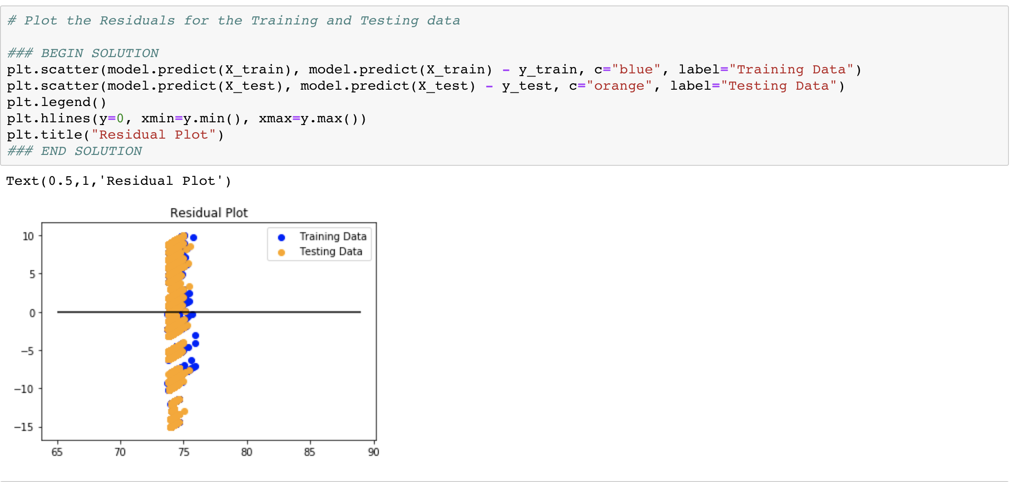
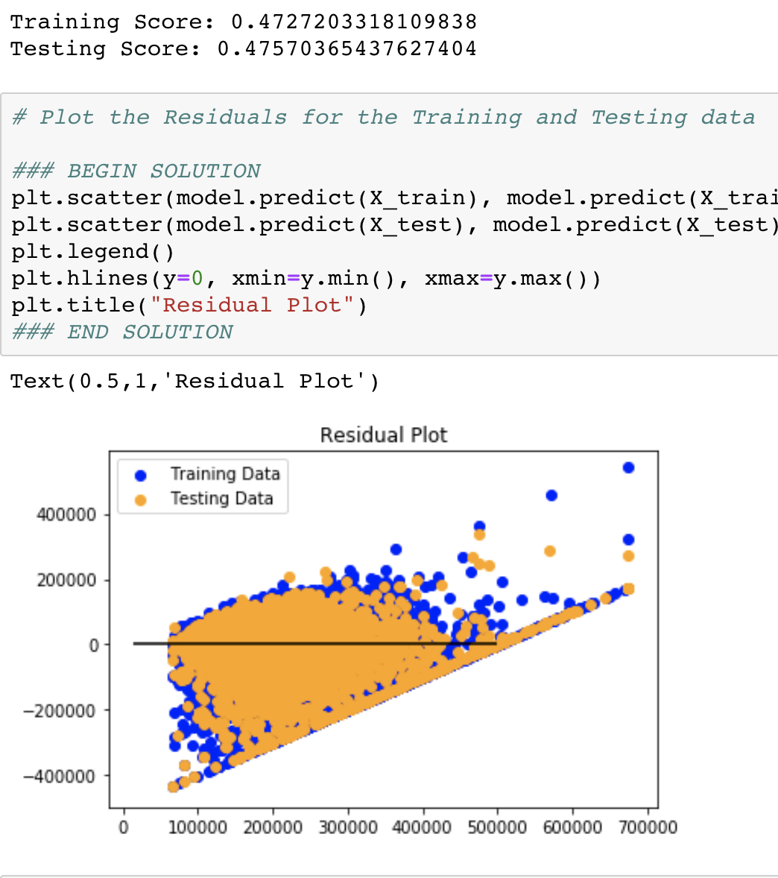
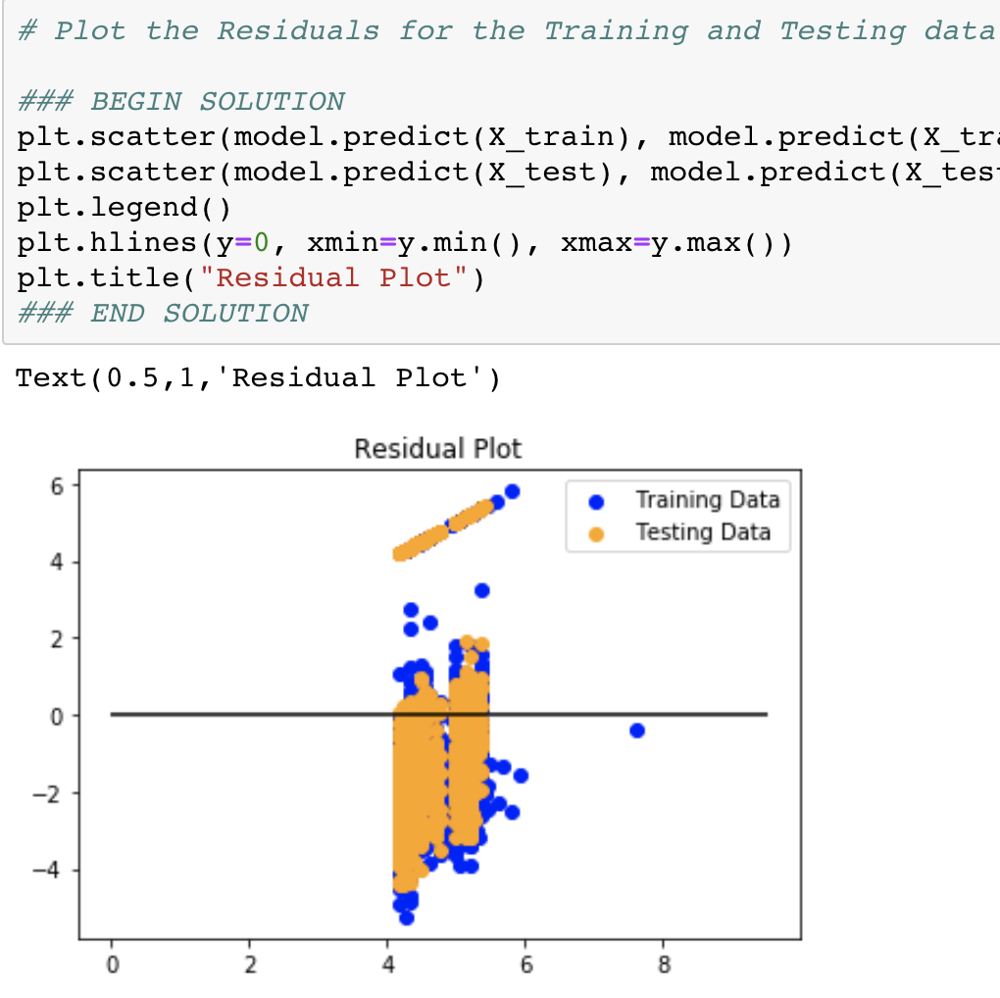
Sample output from data sets and algorithms: BEER FOAM
USGS Earthquakes
Flights
Cal Housing
Notes:
Aref Slide

Slide 22
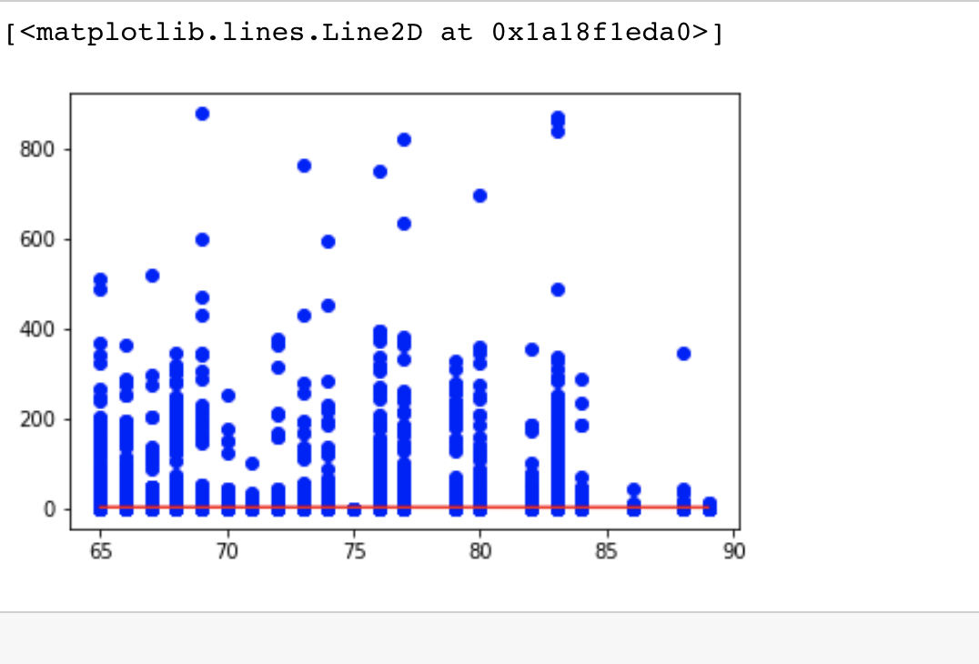
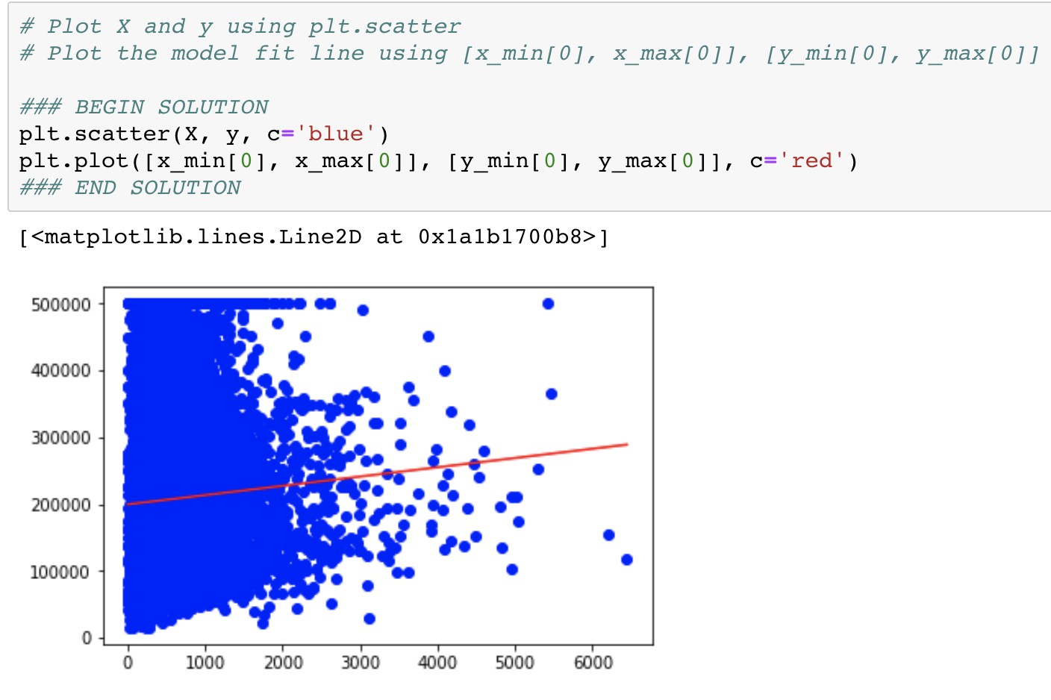
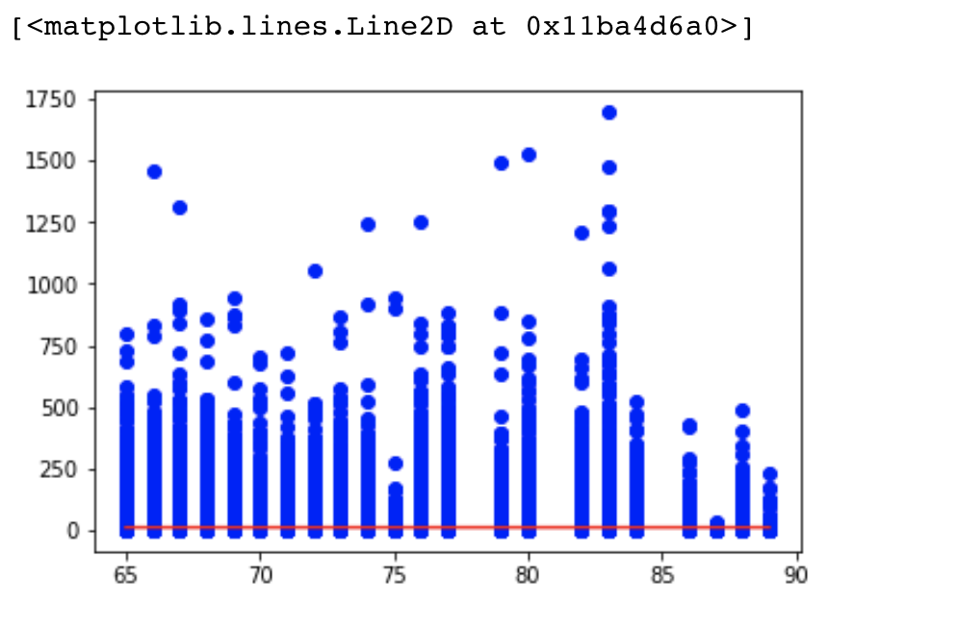
Sample output from data sets and algorithms: Univariate
Cal Housing
Flights
USGS Earthquakes
Notes:
Aref Slide

Slide 23
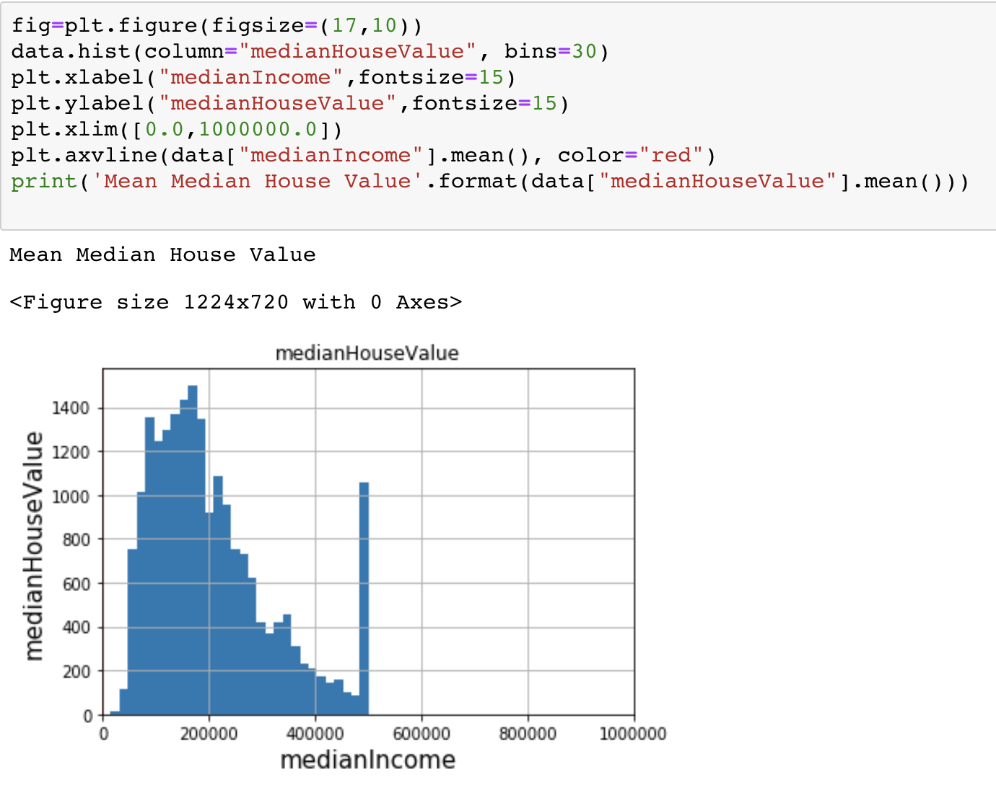
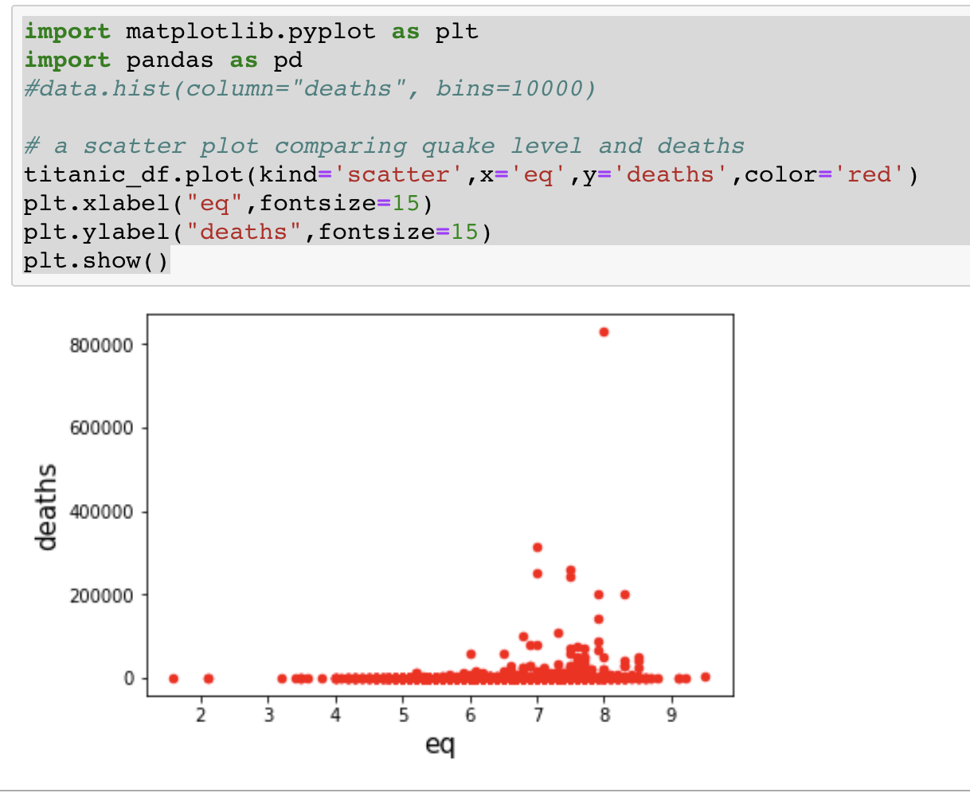
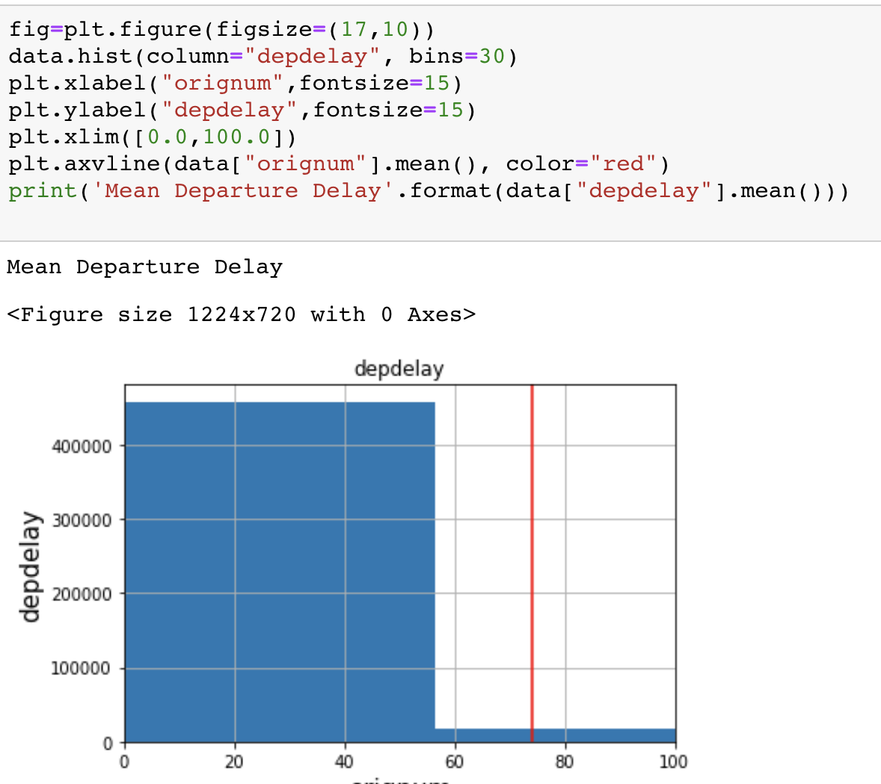
Sample output from data sets and algorithms: Simple Plot
USGS Earthquakes
Cal Housing
Flights
Notes:
Aref Slide

Slide 24
Future Work
The culmination of this work would be a Meta-Machine Learning system that can determine the characteristics of any given dataset automatically, clean, classify/categorize the data; i.e. develop & analyze metadata, and apply the most relevant ML algorithms.
It will also continuously apply ML to itself over time to update its techniques, algorithms and decisions as new sets of data become available and/or are created.
Would love to try Yellowbrick Machine Learning Visualization…
Notes:
Aref Slide

Slide 25


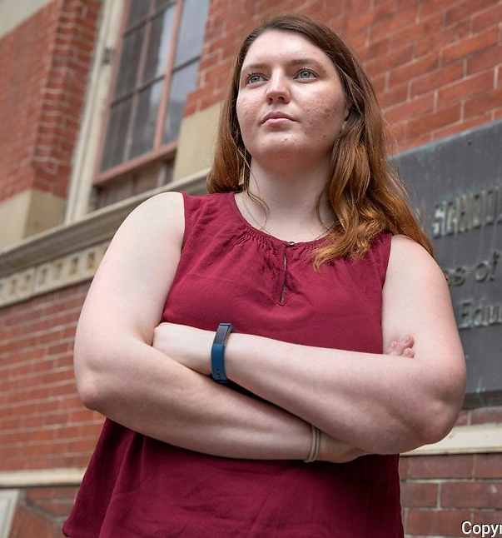

Special thanks to our instructors!

